Slide 1



Social Media Platform
Connecting Moms Everywhere

Slide 2
Proposal by
Bo Kyung Kim
Karina De Vargas Pereira
Sophie Hsu
John Abbott College – FSD10

Slide 3
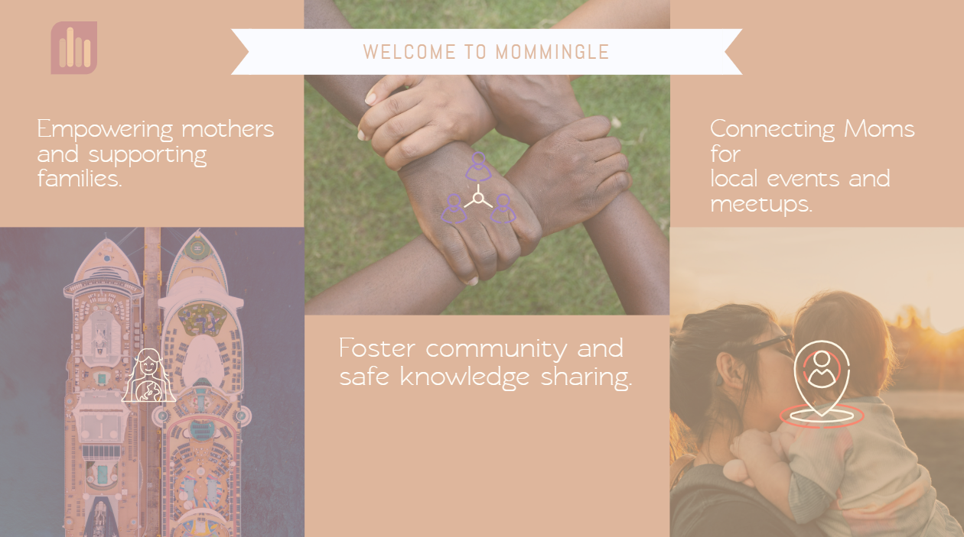


Slide 4
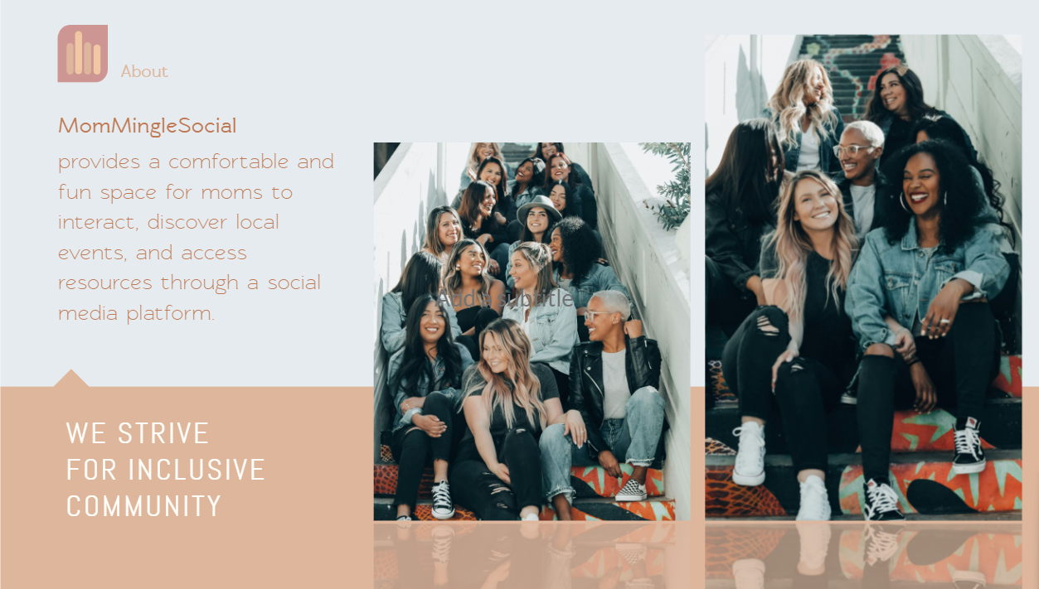


Slide 5
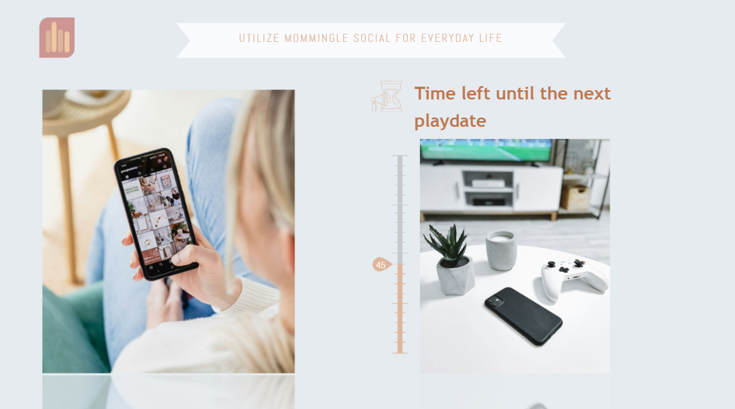

Slide 6

Project Description
Versatile:
Designed to cater to various lifestyles, schedules, and preferences.
Inclusive:
Fosters a supportive and inclusive community for all types of moms.
Features:
Range of features and functionalities to accommodate diverse needs.

Slide 7







Back-end:
Node.js
Express.js
Technologies Used
Front-end:
React.js
HTML
CSS
JavaScript
Database:
MySQL
Authentication:
JSON Web Tokens (JWT)

Slide 8
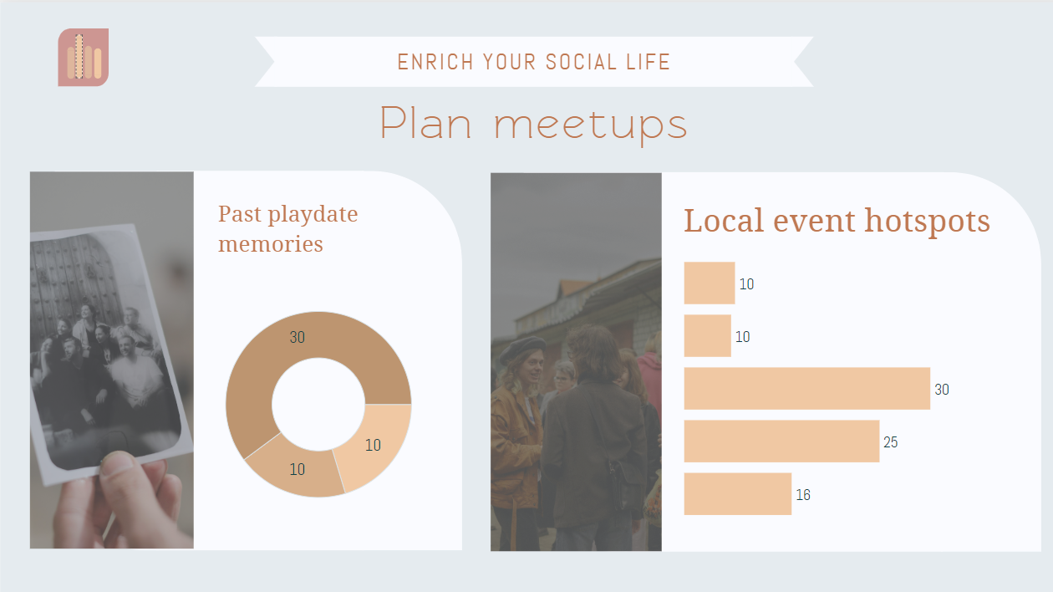

Slide 9
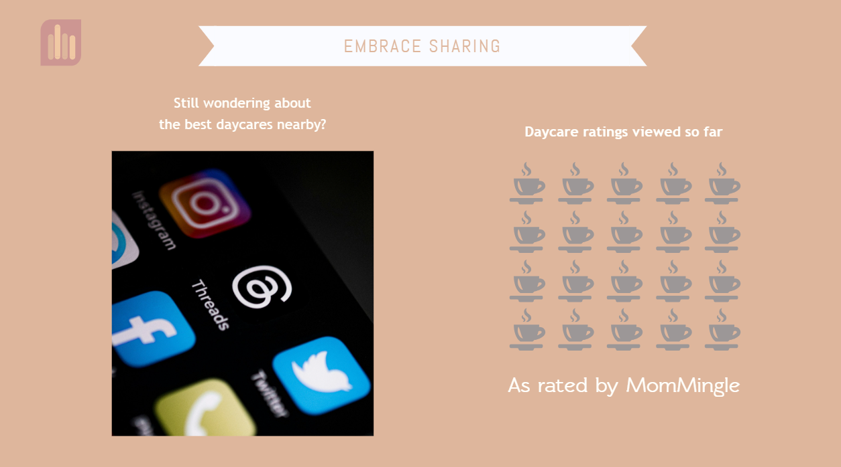

Slide 10
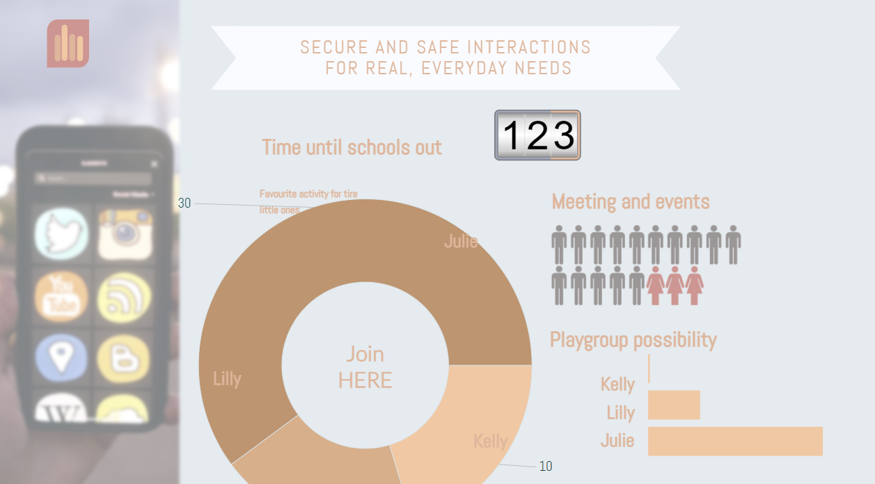





Area Filters
Event Planning
Messaging
View Attendees
Event Comments

Slide 11

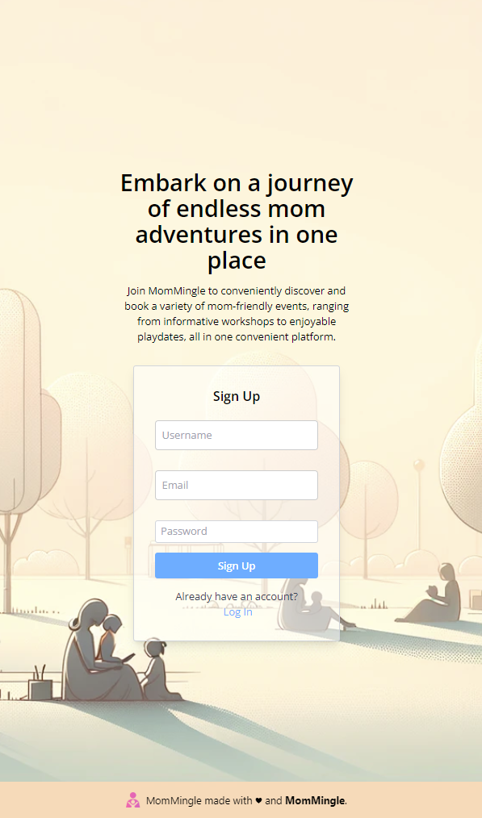
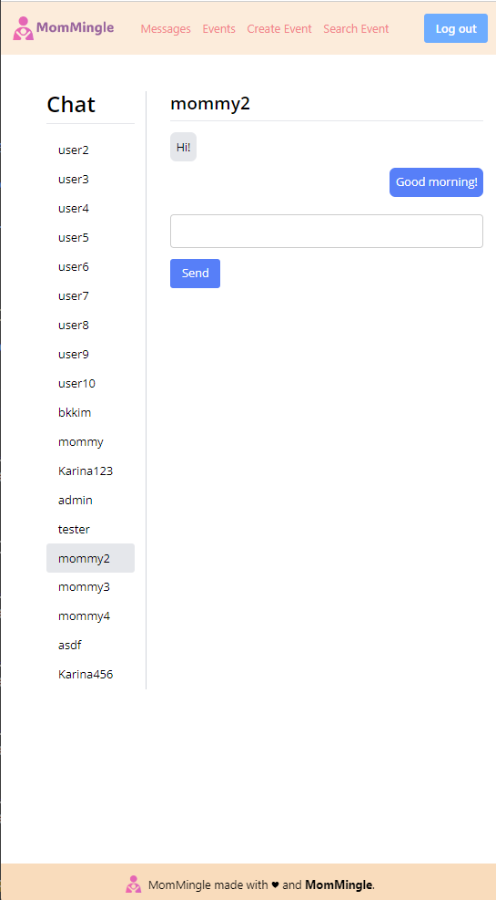
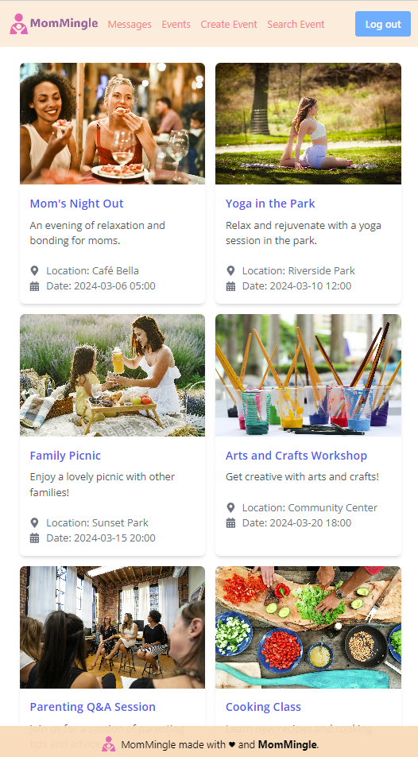
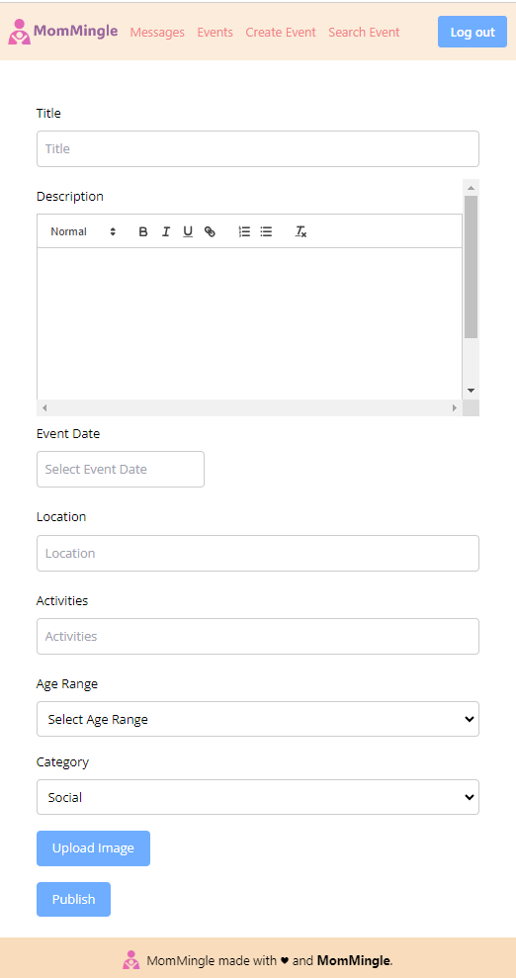
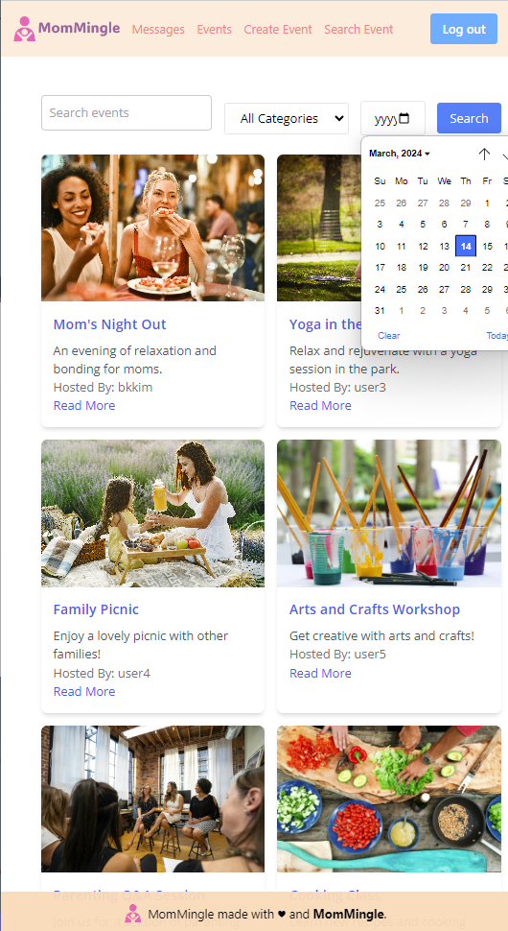
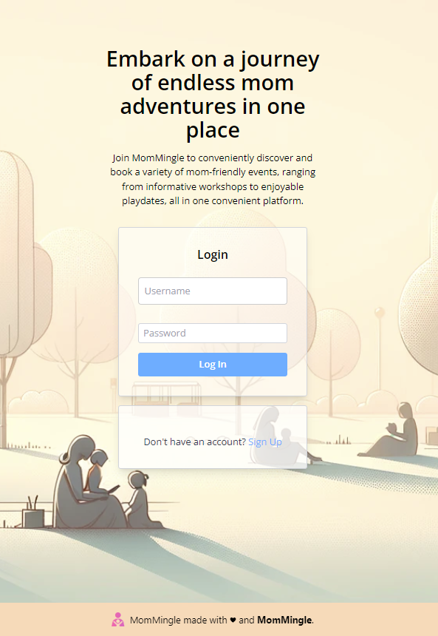
MomMingle Screenshots

Slide 12
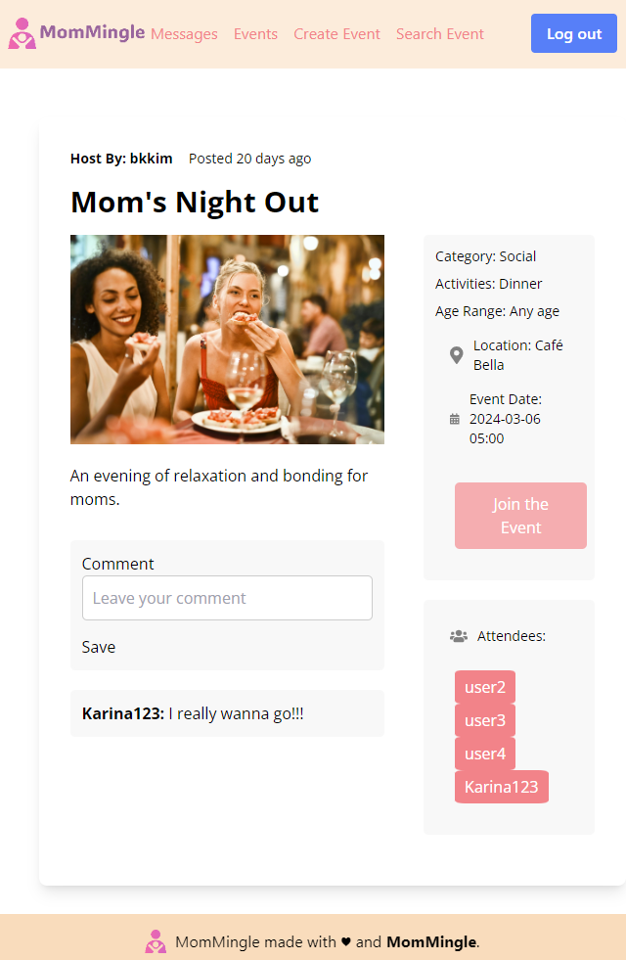
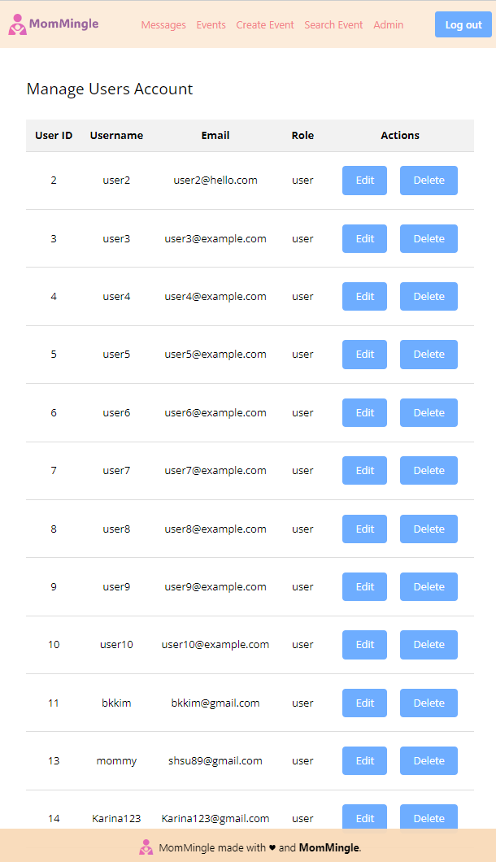
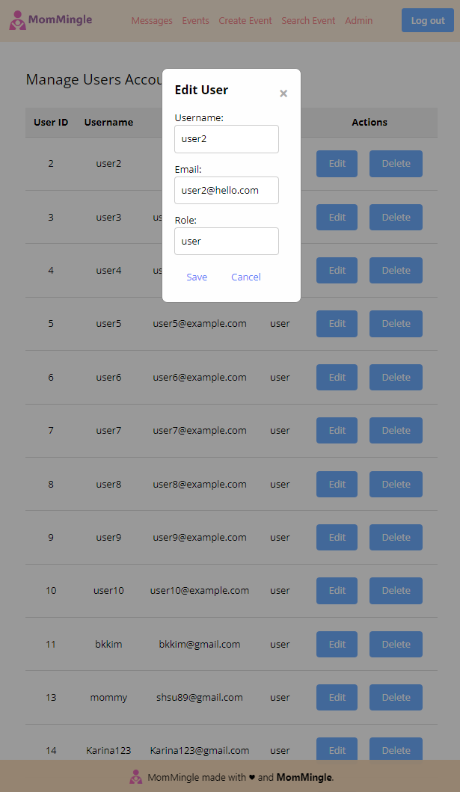
MomMingle Screenshots

Slide 13
Future Work
Google API:
Search feature with geolocation.
Unattend Button:
Attendee has the option to unattend an event after joining it.
Future Work:
Range of features.

Slide 14
Thank You!
Any Questions?

